Slide 1
Characterization of Landscapes and Key Community Systems (KCS)
Partner logo
Massama, January 30, 2025 The Future of Beaches and Coastal Ecosystems in Sardinia: What Actions to Face Climate Challenges?
Marta Debolini, CMCC

Slide 2
The landscape and its functions
A "landscape" refers to a specific part of a territory as perceived by people, whose character results from the interaction of natural and/or human factors.
Landscapes play important cultural, ecological, environmental, and social functions and represent a valuable resource for economic activities.
If properly safeguarded, managed, and planned, landscapes can contribute to job creation.
They shape local cultures and are a fundamental component of Europe's cultural and natural heritage, contributing to human well-being, satisfaction, and European identity.
Landscapes are a key element of quality of life everywhere—whether in urban or rural areas, degraded zones, or high-value landscapes, including both exceptional places and everyday environments.

Slide 3
Landscape Characterization
The characterization of landscapes is a process that identifies, describes, and classifies their physical, ecological, and cultural attributes.
This process integrates spatial data, topography, land use, vegetation, and hydrology, aiming to understand how landscapes influence and are influenced by climate..
Why is Landscape Characterization Important?
Identifies vulnerabilities and strengths of ecosytems.
Provides insights for sustainable land management practices.
Guides territorial planning to mitigate climate risks.
Supports the conservation of biodiversity and ecosystem services.
.

Slide 4
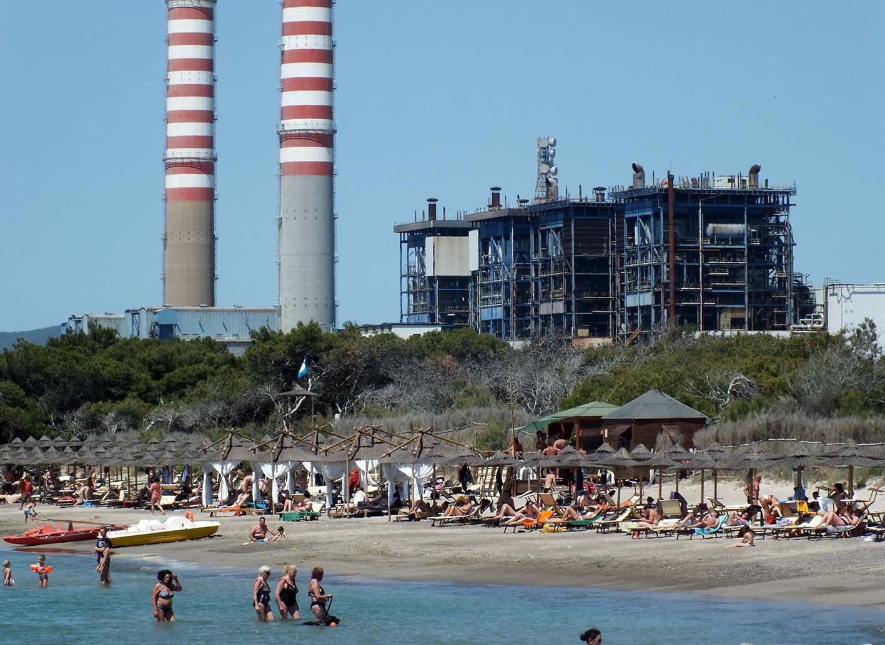
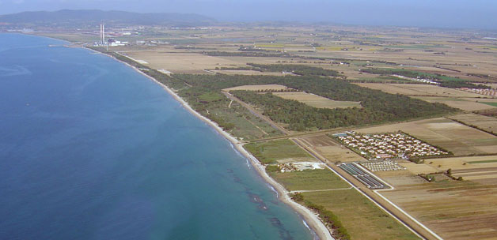

Slide 5
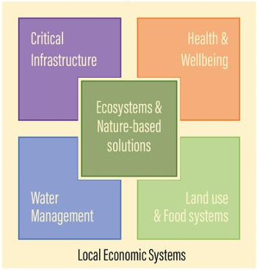
Key Community Systems (KCS)
Key Community Systems (KCS) are systems that fulfill essential societal needs but are increasingly affected by climate change.
This approach analyzes social, economic, and infrastructural components of communities to assess their resilience and vulnerability to climate change. It focuses on interdependencies and critical systems such as:
Key Components of KCS Analysis:
Population demographics
Economic factors and livelihoods
Critical infrastructures
Community networks and governance
Infrastrutture
Critiche
Salute e
benessere
Ecosistemi e
Soluzioni
basate
Sulla natura
Gestione
Delle risorse
Uso del suolo
e produzione
agricola
Settori economici locali

Slide 6
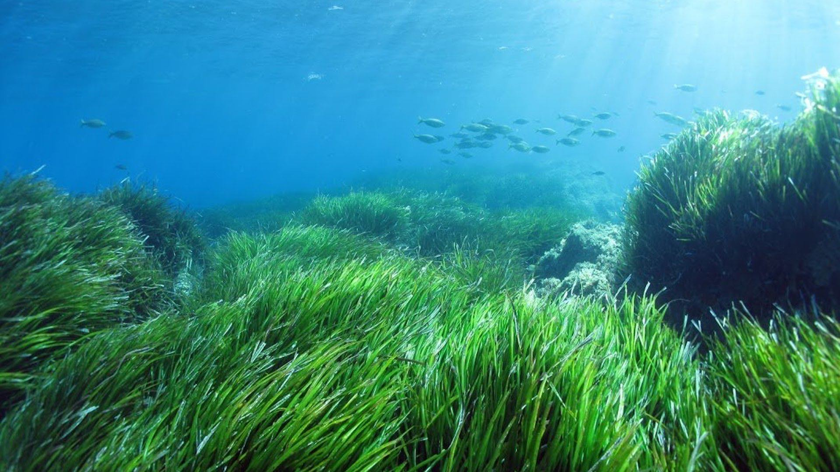
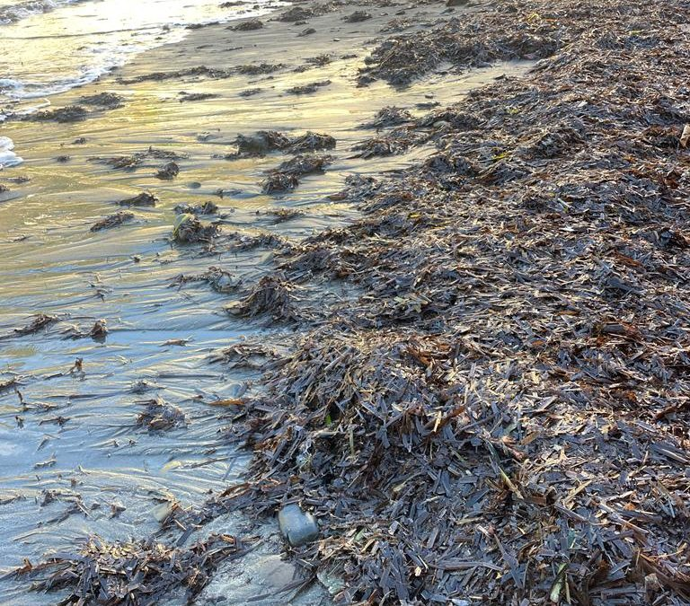
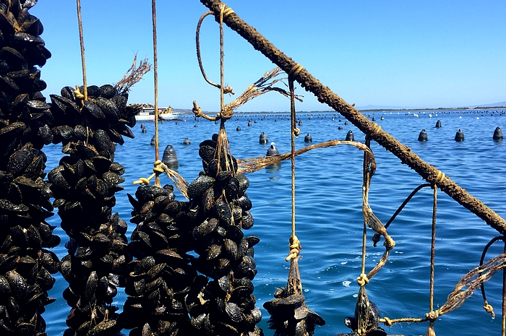
Examples of KCS in Coastal and Marine Areas
Infrastrutture
Critiche
Salute e
benessere
Ecosistemi e
Soluzioni
basate
Sulla natura
Gestione
Delle risorse
Uso del suolo
e produzione
agricola
Settori economici locali

Slide 7
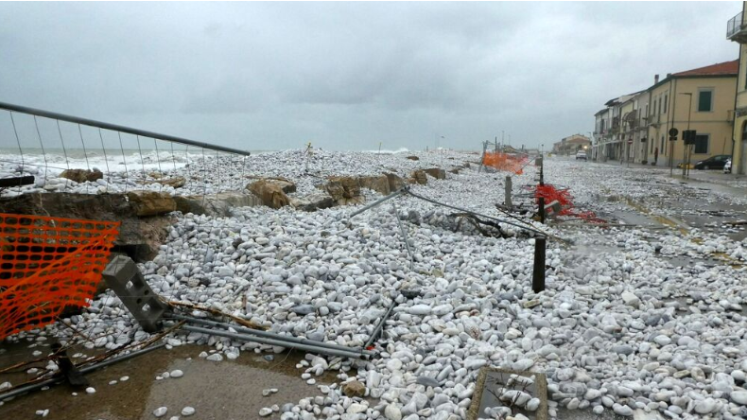
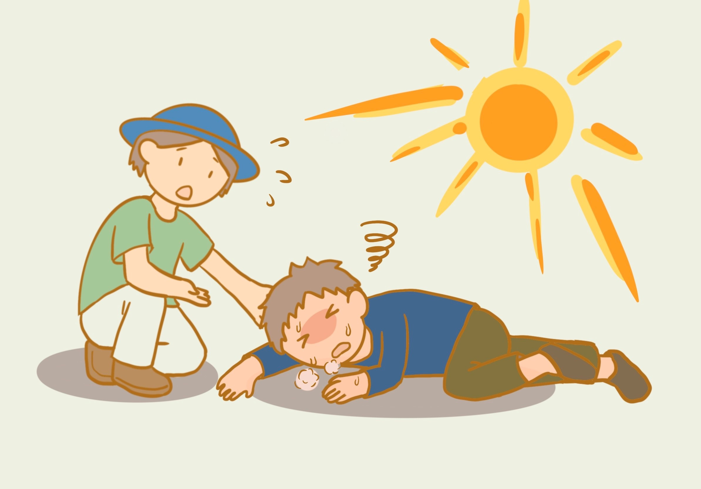
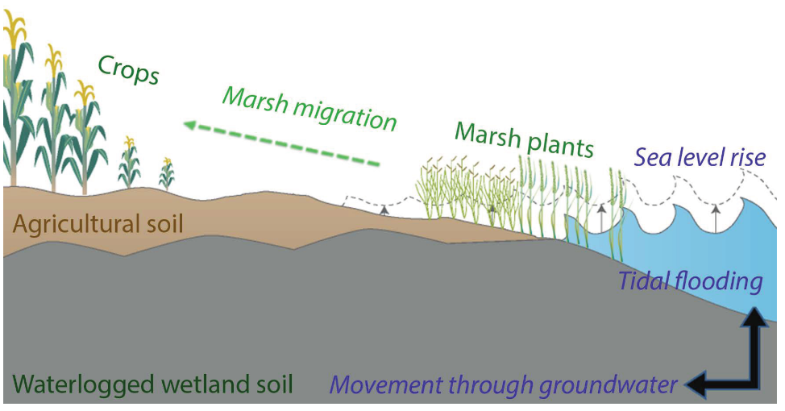
Examples of KCS in Coastal and Marine Areas
Infrastrutture
Critiche
Salute e
benessere
Ecosistemi e
Soluzioni
basate
Sulla natura
Gestione
Delle risorse
Uso del suolo
e produzione
agricola
Settori economici locali

Slide 8
Key Community Systems (KCS)
Why is characterization of CC impacts in KCSs important?
It is needed to identify local vulnerabilities
It is needed to assess the adaptive capacity of local populations
It is useful for supporting targeted interventions to improve resilience
Promotes equitable adaptation strategies, responding to the diverse needs of communities.
Why integrate landscape and key community systems analysis into climate risk assessment?
Landscape characterization provides a physical and ecological basis, while KCS analysis identifies human and infrastructure factors.
Integration provides a comprehensive view of risks so that the best adaptation and mitigation strategies can be identified

Slide 9
Thank you!
Marta.debolini@cmcc.it

