Slide 1
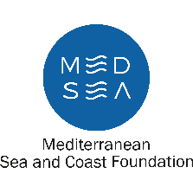
The Future of Beaches and Coastal Ecosystems in Sardinia: What Actions to Address Climate Challenges?
Aims, objectives and expected results of the project
Mario Deriu
Assessorato della Difesa dell’Ambiente
Servizio tutela della natura e politiche forestali(TNPF)
Settore Difesa del suolo e delle coste
mderiu@regione.sardegna.it
First regional workshop
30 January 2025

Slide 2
https://www.desirmed.eu/

Slide 3
SARDINIA Regional Cluster
Regione Autonoma della Sardegna (RAS)
CNR-IAS
CRITERIA
IMC
MEDSEA

Slide 4
The Project
DesirMED (Demonstration and mainstrEaming of nature-based Solutions for climate Resilient transformation in the MEDiterranean) funded by the Horizon Program, involves a multi-level set of actors working side by side with scientific partners to promote and to implement transformative adaptation to increase the capacity of Mediterranean regional communities through transformative approaches to climate change
Objectives: To test innovative governance solutions for nature conservation using ecosystem-based approaches.
Region-wide study of CC impact on beaches (shorelineand Posidonia), mainly caused by sea level rise & increase of extreme events
Region-wide study of green infrastructure & associated ecosystem services
Duration: 60 months starting from 01.01.2024.
Project amount: € 17.733.793 of which:
€ 1.679.262,5 for the cluster regionale (RAS, CNR, IMC, MED SEA, CRITERIA);
Notes:
Provide an overall description/picture of the socio-economic context of the study area, its characteristics and peculiarities, its development, etc. Pictures are welcome!!!

Slide 5
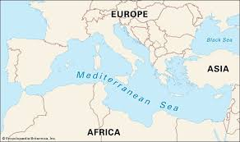
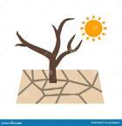
Main regional climate hazards
Fragmentation and overexploitation of natural resources
Anthropic pressures from tourism
Climate change:
MEDITERRANEAN SEA:
- modest extension
- semi-enclosed sea
- global warming can cause faster biological responses than in other systems (PNACC, 2023)
Sea level rise
Rising Temp
Flood
Heat waves
Drought
Biodiversity & ecosystem services loss
Coastal erosion
Notes:
Provide an overall description/picture of the socio-economic context of the study area, its characteristics and peculiarities, its development, etc. Pictures are welcome!!!

Slide 6
European projects as a response to threats
The Region of Sardinia, together with other Mediterranean countries, is responding to these challenges by launching European projects and strategies for the biodiversity management under the European Interreg and Horizon programmes. These include the DesirMED, AMMIRARE and Natour4Cchange projects, which are currently being implemented by the Regional DG Environment.
In particular, the EU-funded AMMIRARE and DesirMED projects, in collaboration with Sardinian partners, are developing a detailed database of Sardinian coastal systems (beach-dune systems), based on remote sensing data (orthophotos) and field surveys. The database will contain all the specific elements (e.g., sediment characteristics, rocky outcrops in the sea, Posidonia meadows, anthropization of the backshore etc.) that will allow for detailed prediction of the effects of sea level rise on previously defined beaches and identify, in this way, the vulnerable areas.
The implementation of the database has already begun and will will be extended over the course of the projects, for the entire Sardinia coastline, as a part of the Climate Change Adaptation Strategy.
This tool will help decision makers to make decisions on coastal management and planning for adaptation to climate change.

Slide 7
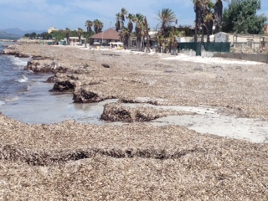
Some activities of the Office
Posidonia Monitoring and management
In order to improve the management of posidonia in beaches, a contract is currently underway for the preparation of a technical specification for the classification of beaches and the drafting of regional guidelines for the drawing up of the management plan for posidonia in beaches, in accordance with Article 1 of the Regional Law of 21 February 2020.
In summary, the thecnical specification should:
Identify the descriptive elements of beaches and how (standard) to acquire;
typification of beaches and their classification Definition of management models;
Guidance for drafting Beach Management Plans.
The next step is the implementation of the regional plan for posidonia management, which will take into account the characteristics of the beaches and their vulnerability, defining for each the most appropriate management model.

Slide 8
Some activities of the Office
Project of interventions
In 2023, the revolving fund for the design of coastal defence and redevelopment works was established to enable local authorities to award professional assignments
A total of € 4.9 million has been allocated and, 34 designs have been funded up to date.
This revolving fund makes it possible to start design services before the works are financed, without burdening municipal budgets, in order to have projects “ready” when resources are available to carry out the works.
The most relevant element of this approach of proceeding is that we will be able to finance concrete works that have already been evaluated and designed, and thus the full implementation of what has been designed is guaranted.

Slide 9
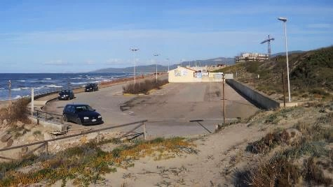
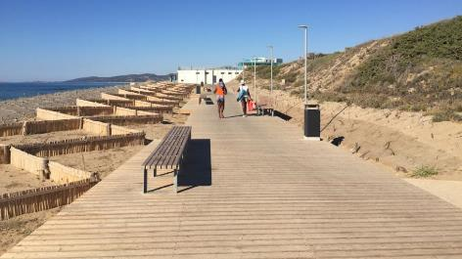
Some activities of the Office
Scheduling of interventions.
From 2011 up to date, 50 interventions were planned:
€ 50.000.000,00
Works completed 16 (approximately € 21.000.000,00)
Works in progress 7
Works in the design phase 12 (of which 4 advanced)
Works in the startup phase 15 (years 2022/2023)

Slide 10
We cannot afford to treat our land as an unlimited resource. Every decision we make can make the difference between preserving the beauty of our land for future generations or losing it to an unsustainable development model. This is where the concept of sustainable land management comes in.
Thank you!
mderiu@regione.sardegna.it

